Slide 1
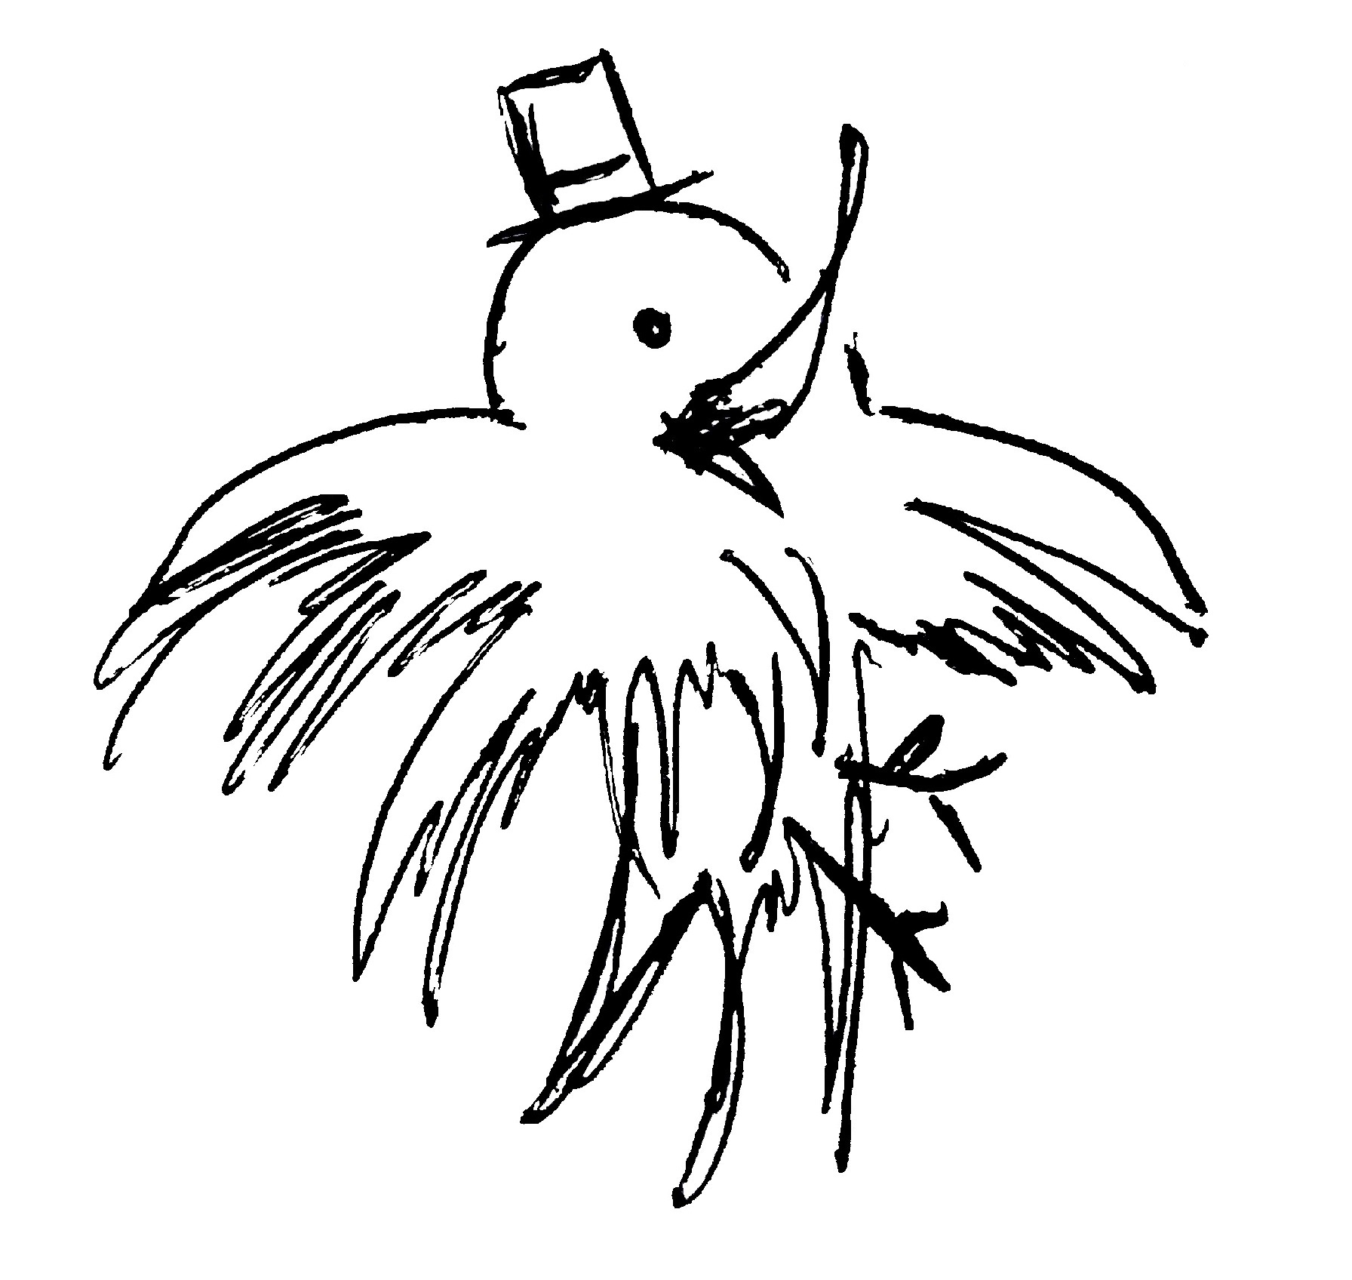
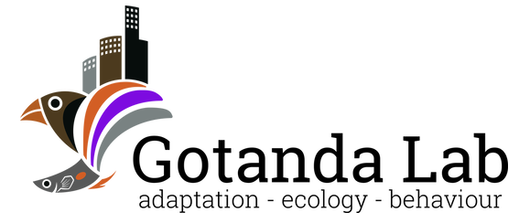

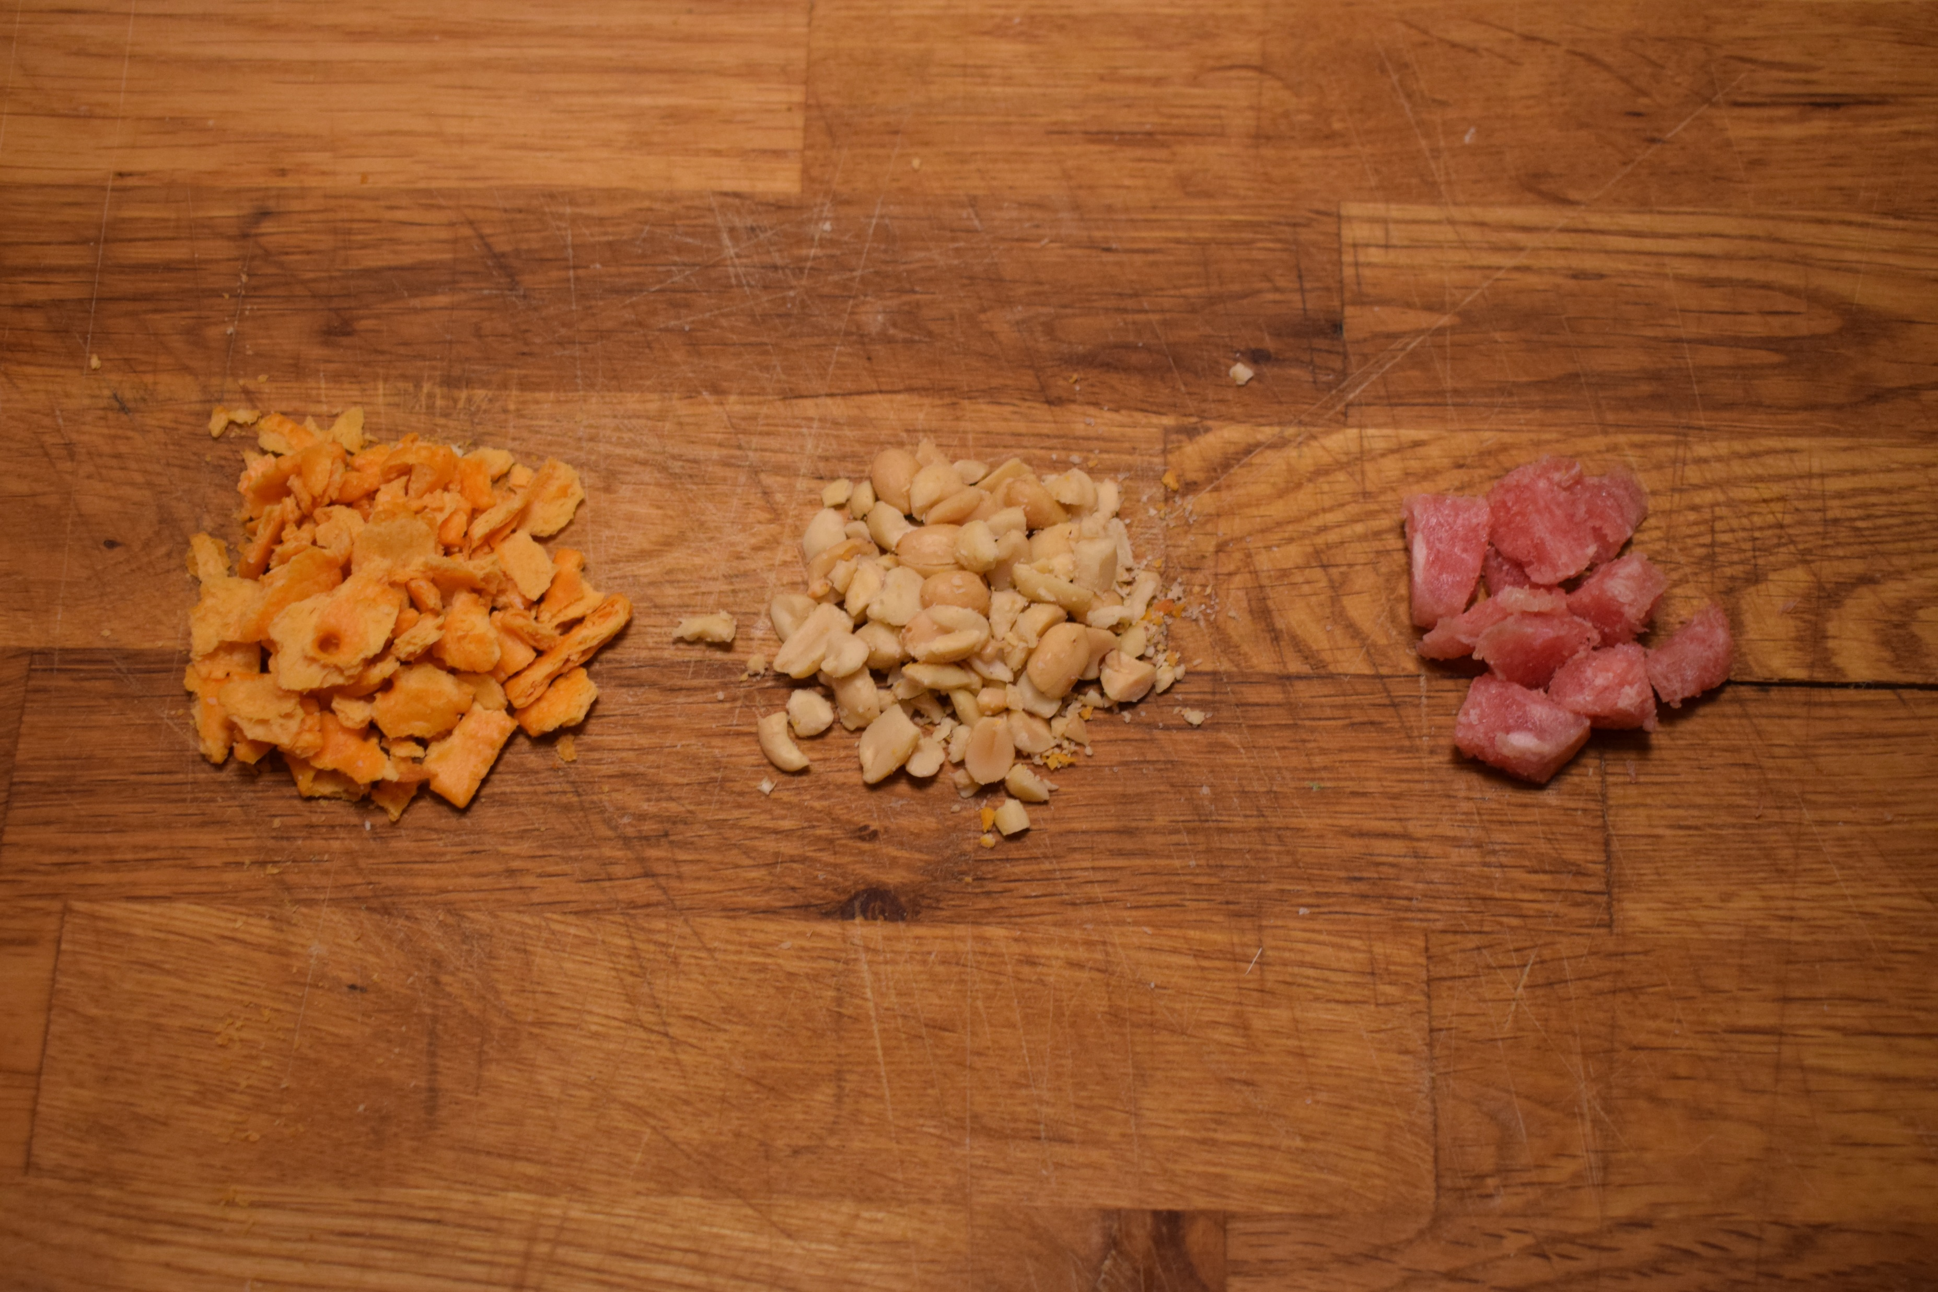
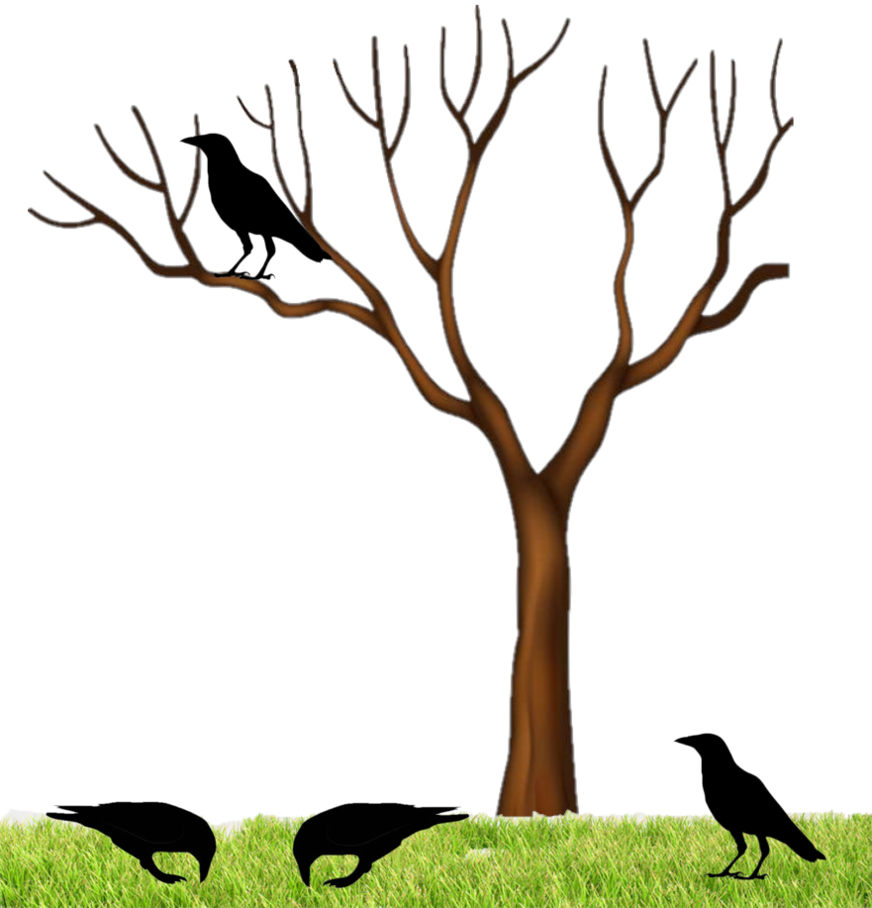
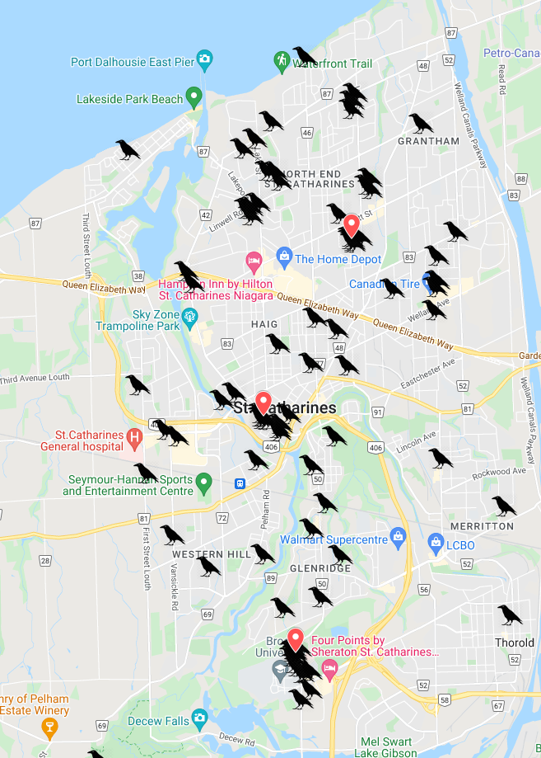
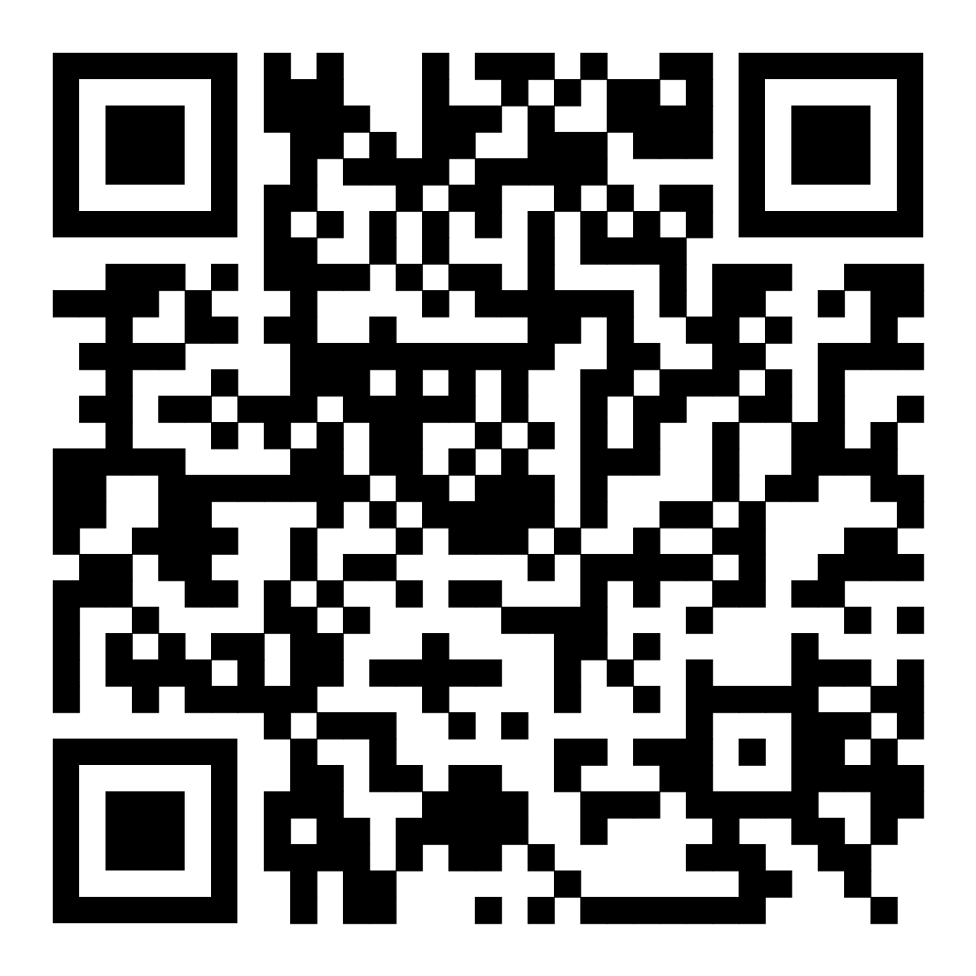
Urbanization and social antipredator behaviour in American crows Alex Popescu – ap21pb@brocku.ca // crowkemon.weebly.com Department of Biological Sciences, Brock University
Introduction
The abundance of American crows in North American cities has increased over the years, suggesting that they benefit from living in urban areas. Urbanized species can have adapted behaviours to better exploit anthropogenic benefits. Adaptations at the individual level have been observed in many species and include changes in foraging behaviour and decreased wariness of humans. However, adaptations of social behaviours are underexplored. The American crow is highly social and changes in social behaviour can affect its fitness in urban areas.
Do adaptations of social behaviours contribute to the success of American crows in urban areas?
Urban areas
Access to an abundance of human foods
Varying quantity and quality
Increased frequency of interactions with humans
Decreased abundance of natural predators
New sources of stress and mortality
Sentinel behaviour
Objectives and Hypothesis
Objective: To observe differences in social antipredator behaviour in areas of varying levels of urbanization and proximity to humans.
Hypothesis: American crows in urban areas and in greater proximity to humans will have altered social antipredator behaviour.
Predictions: Urban crows are predicted to forage in smaller groups and in a more individualistic manner because of decreased wariness of humans and the presence of fewer natural predators.
Why pre-bait the test sites?
Reinforced association between location and food presence
Familiarization of crows with the presence of the observer
Increased likelihood of crows being present
Factors
Human presence
Local human population density
Frequency of human disturbances during tests
Level of urbanization
Urban, suburban or rural
Type of land use – Commercial, Residential, Industrial
Experimental design
Observational study of crow foraging events
Supplying foods of varying quantity and quality
Measures of social antipredator behaviour
Social variables: Time spent in sentinel role, average time spent foraging with/without sentinel
Individual variables: Frequency of antipredator behaviour while foraging
Food types
Increased safety from predators
Increased foraging efficiency
Costly behaviour for sentinel individual
Cannot forage while being sentinel
Site selection
Figure 2: Crowkémon Go in St. Catharines. Crow markers represent individual spotting events. Red markers show May testing sites.
Crowkémon Go
A
Figure 3: One portion (10g) of each type of food used during the experiment from left to right: Cheez-its, Peanuts, Meat morsels
Cheez-its
Processed human food- Lowest nutritional value
Peanuts
Unprocessed human food – Average nutritional value
Meat Morsels
Natural food – Greatest nutritional value
Individuals can choose to either forage individually or socially.
Impacts
Can help predict how other urbanized social species might respond to the rapid, global increase in urbanization
Social
Individual
B
Figure 1: Representation of crows foraging near a tree showing social (A) and individual (B) antipredator behaviour.
Acknowledgements
For their help, advice and support: Dr. Kiyoko M. Gotanda, Albert Wu, Dr. Anne B. Clark, Ian Gordon, Dr. Liette Vasseur, and Lilianne Caron
Human Density
Urban vs. non-urban area

